Slide 1

Development of a Dual-sensor Wearable Phonocardiogram and Application of Signal Processing Techniques for Heart Sound Denoising and Segmentation
Yui Harayama
MEng Biomedical Engineering - Imperial College London
Supervisors: Dr Firat Güder and Dr Yasin Çotur

Slide 2


Motivation of the Project
1/19
Cardiovascular diseases are the leading cause of death globally [1]
Comparison of existing diagnostic methods:
Diagnosis Method | Characteristics
Electrocardiography (ECG) | Unable to detect murmurs and cumbersome process [2]
Auscultation | Limited by the human audition and depends on listening abilities of the physician [3]
Phonocardiography (PCG) | Easy process and provides an objective assessment of complex heart sounds [4]
Notes:
The most used existing diagnosis methods are ECG
Therefore, pcg which overcomes these challenges was identified as a promising alternative

Slide 3
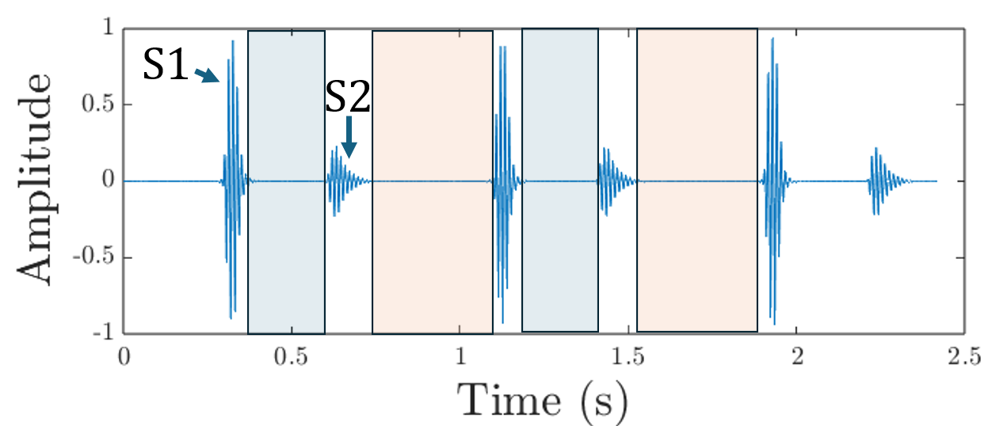
Selected Method: Phonocardiography
2/19
PCG: plot of the recording of the sound and murmurs produced by the mechanical activity of the heart. Recordings are achieved using microphone sensors.
Fundamental heart sounds (FHS): S1 and S2 produced by closure of cardiac valves
Systole
Diastole
Note:
PCG is sensitive to noise → requires specifically-designed wearable for signal acquisition and signal processing for the denoising of noisy heart sounds.
Lack of research focused on multi-sensor-based denoising algorithms → address this gap
Notes:
More specifically ‘dual-sensor’

Slide 4
Aim and Objectives
3/19
Aim:
To develop a wearable dual-sensor system to perform PCG in uncontrolled environments.
Objectives:
1. Design a wearable phonocardiogram building upon research group’s work
2. Tuning of the Denoising Algorithms’ Parameters using Simulated Data.
Compare the dual-sensor-based Adaptive Noise Cancellation (ANC) and Dual Spectral Subtraction (DSS) with the widely used single-sensor-based Discrete Wavelet Transform.
ANC: Utilised by a few research, but denoised simulated heart sounds contaminated with White Gaussian Noise (WGN).
DSS: Only utilised by one research. Used real-world heart sounds but reported to achieve ‘moderate success’ without further specification [5].

Slide 5
Aim and Objectives
4/19
Aim:
To develop a wearable dual-sensor system to perform PCG in uncontrolled environments.
Objectives:
1. Design a wearable phonocardiogram building upon research group’s work
2. Tuning of the Denoising Algorithms’ Parameters using Simulated Data.
Compare the dual-sensor-based Adaptive Noise Cancellation (ANC) and Dual Spectral Subtraction (DSS) with the widely used single-sensor-based Discrete Wavelet Transform.
3. Denoising of Real-world Heart Sounds Using the Optimised Algorithms.
Heart sounds are acquired using the proposed dual-sensor system.
4. Segmentation of Denoised Heart Sounds.

Slide 6
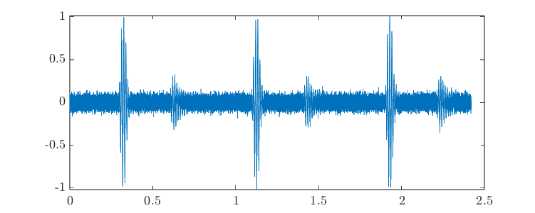

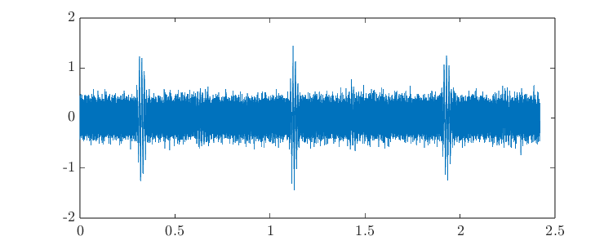
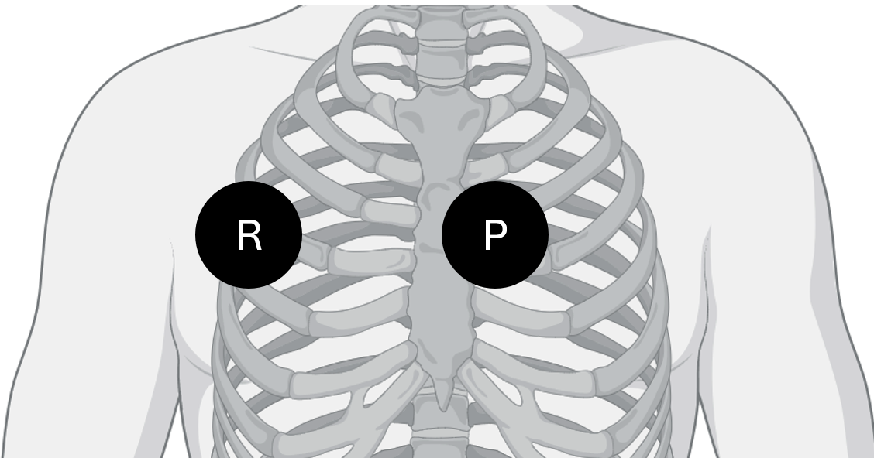
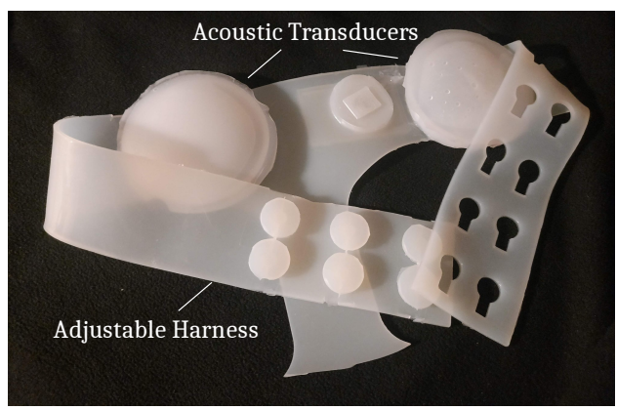
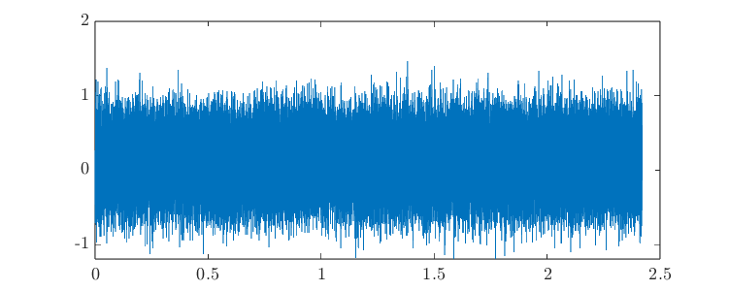
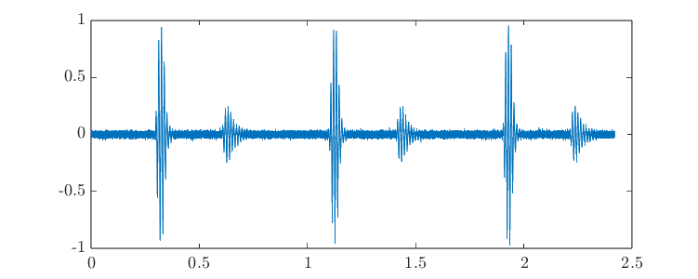
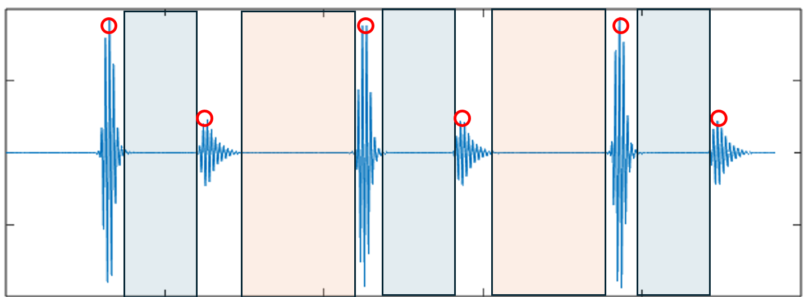
Methods: Overview
Methods: Overview
5/19
Optimal parameters of each algorithm
Objective 2
Simulated heart sounds contaminated with noise (WGN)
Tuning of the denoising algorithms’ parameters
P
R
P
Denoising Algorithms
Objective 3
R
Acquire heart sounds using dual-sensor wearable
S1
S2
Segmentation Algorithm
Objective 4
Sys
Dias
Denoised heart sounds
Notes:
the simulated heart sounds contaminated with noise are used to tune the algorithms’ parameters. Optimal parameters are then used to denoise real world heart sounds acquired using our proposed dual sensor wearable. Two sensors are used; the primary sensors collects the noise contaminated heart sound while the reference sensor collects noise only. Denoised heart sounds are then segmented to obtain s1 s2, systole and diastole.

Slide 7
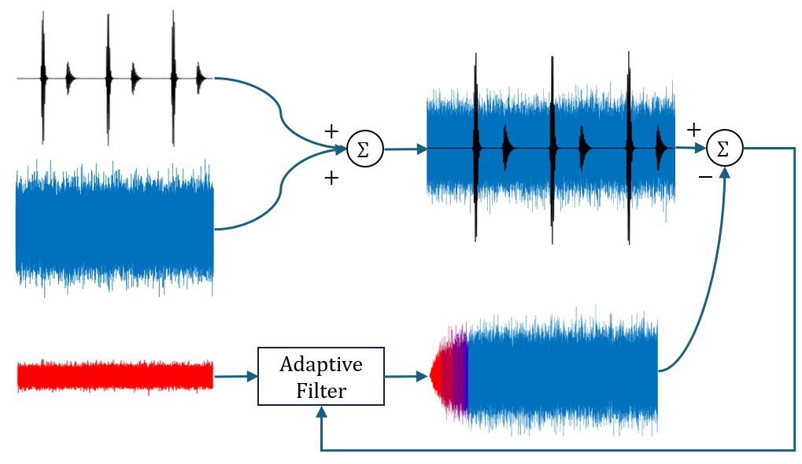
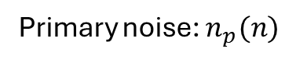

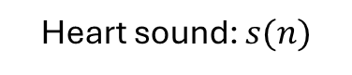
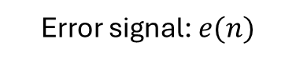

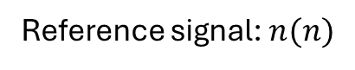
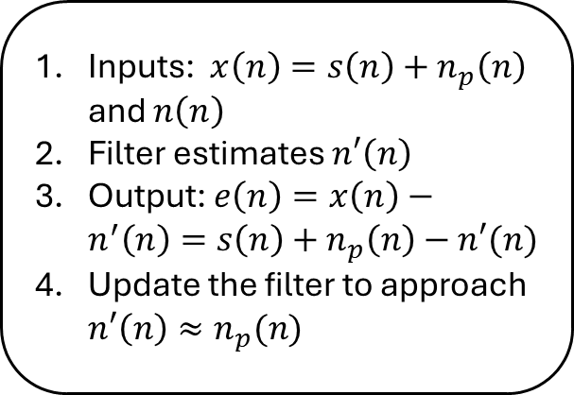
Methods: Adaptive Noise Cancellation
6/19
ANC in time domain
Heart sound: $s(n)$
Primary signal: $x(n)$
Error signal: $e(n)$
Primary noise: $n_{p}(n)$
Inputs: $x\left(n\right)=s\left(n\right)+n_{p}\left(n\right)$ and $n\left(n\right)$
Filter estimates $n′\left(n\right)$
Output: $e\left(n\right)=x\left(n\right)−n^{′}\left(n\right)=s\left(n\right)+n_{p}\left(n\right)−n′(n)$
Update the filter to approach $n′\left(n\right)≈n_{p}(n)$
Estimated primary noise: $n′(n)$
Reference signal: $n(n)$
Update

Slide 8
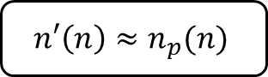
Methods: Adaptive Noise Cancellation
7/19
ANC in time domain
Heart sound: $s(n)$
Primary signal: $x(n)$
Error signal: $e(n)$
Primary noise: $n_{p}(n)$
$$n′\left(n\right)≈n_{p}(n)$$
Estimated primary noise: $n′(n)$
Reference signal: $n(n)$
Update
Notes:
Such that estimated primary noise is close to the primary noise

Slide 9
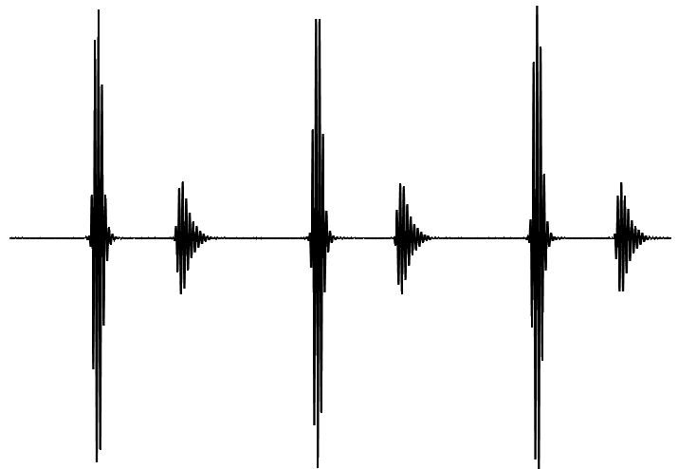
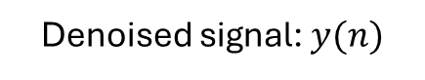
Methods: Adaptive Noise Cancellation
8/19
ANC in time domain
Heart sound: $s(n)$
Primary signal: $x(n)$
Denoised signal: $y(n)$
Primary noise: $n_{p}(n)$
Estimated primary noise: $n′(n)$
Reference signal: $n(n)$
Update

Slide 10
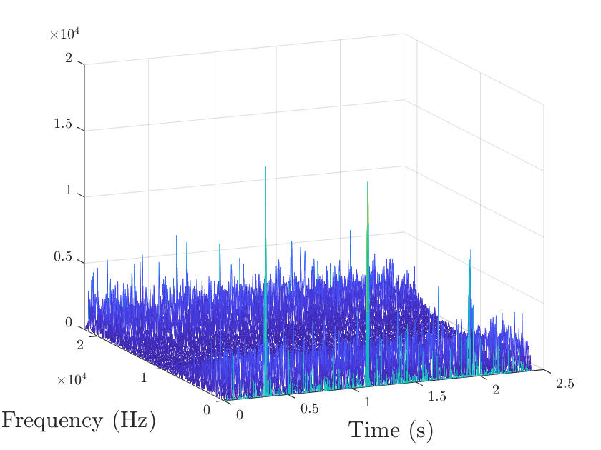
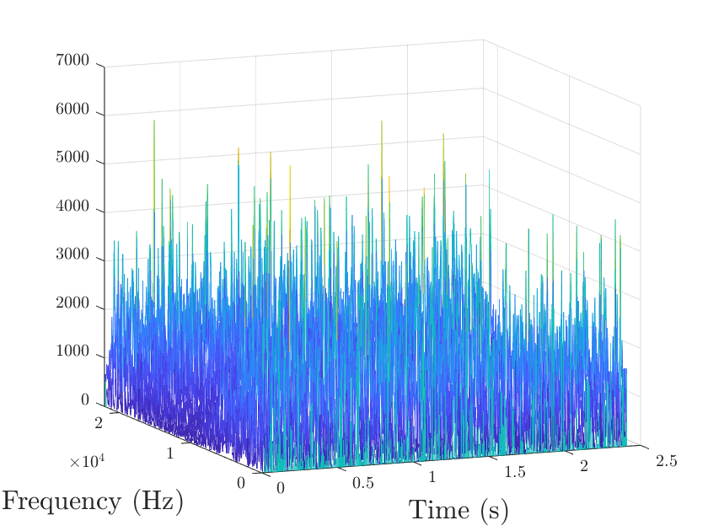
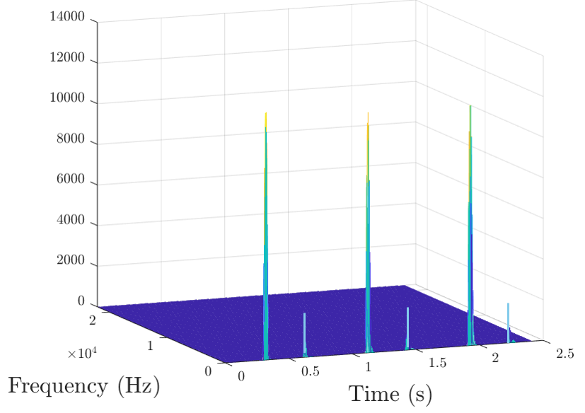
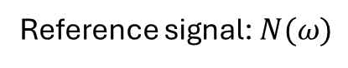


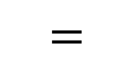

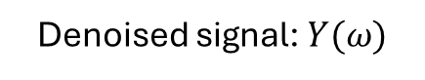
Methods: Dual Spectral Subtraction
9/19
DSS in frequency domain
$$|Y\left(ω\right)|=|X\left(ω\right)|−λ{\left|N\left(ω\right)\right|}^{}$$
Primary signal: $X(ω)$
Reference signal: $N(ω)$
Denoised signal: $Y(ω)$
S1
$$− λ×$$
$$=$$
S2
Attenuation factor: controls the attenuation strength
Notes:
product of the noisy signal spectrum and the frequency response of a spectral subtraction filter

Slide 11
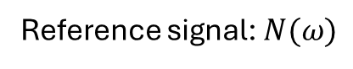


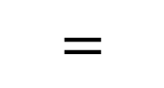
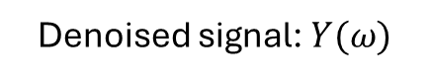
Methods: Dual Spectral Subtraction
10/19
DSS in frequency domain
Primary signal: $X(ω)$
Reference signal: $N(ω)$
Denoised signal: $Y(ω)$
S1
$$− λ×$$
$$=$$
S2
Attenuation factor: controls the attenuation strength
This is the parameter that we are tuning in DSS by denoising simulated heart sounds contaminated with WGN
Values: [0.5, 0.6, 0.8, 1, 1.2, 2, 4, 6, 8, 10]
Notes:
product of the noisy signal spectrum and the frequency response of a spectral subtraction filter

Slide 12
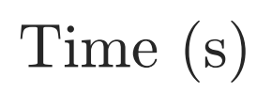
Methods: Dual Spectral Subtraction
11/19
DSS in frequency domain
Primary signal: $X(ω)$
Reference signal: $N(ω)$
Denoised signal: $Y(ω)$
S1
$$− λ×$$
$$=$$
S2
Inverse Fourier Transform

Slide 13
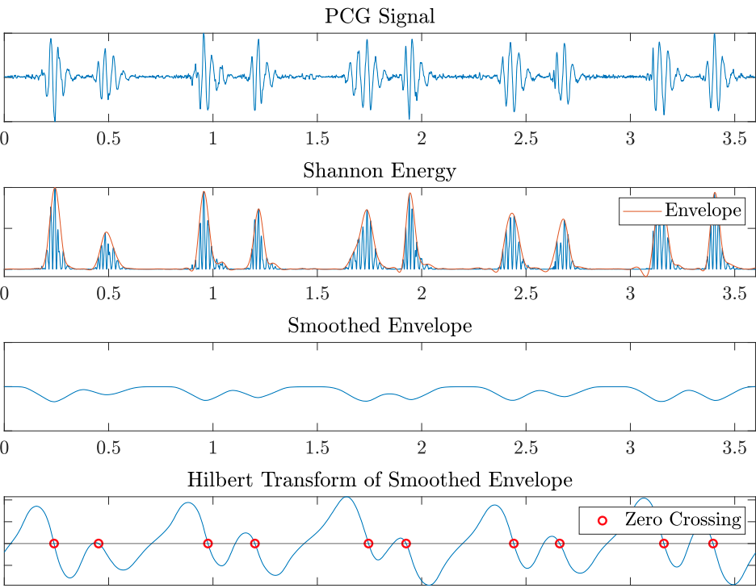

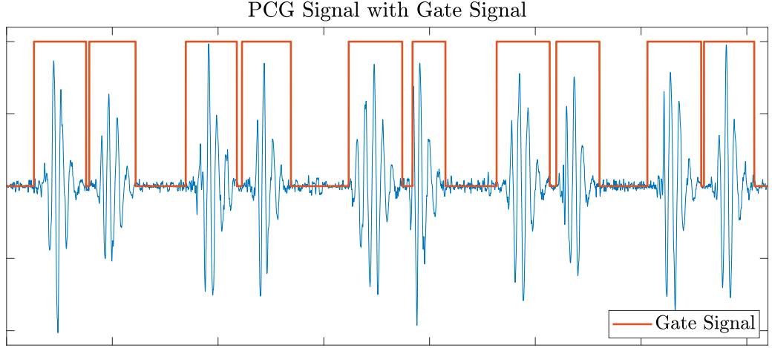
Methods: Segmentation
12/19
Extract the signal’s envelope
2. Smooth the envelope
3. Identify the FHS
4. Identify the boundaries of the FHS

Slide 14
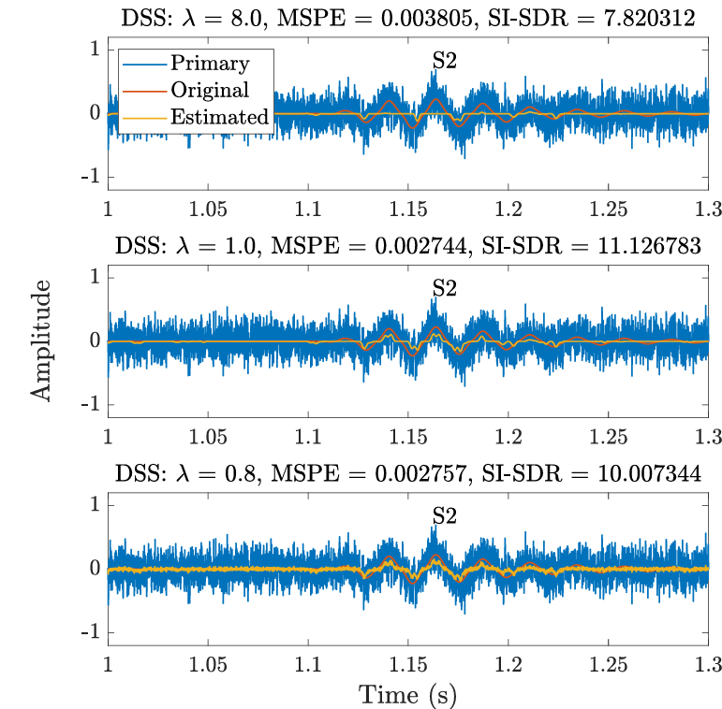
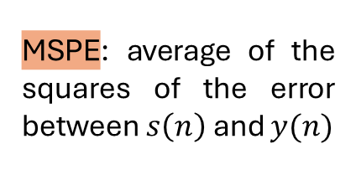
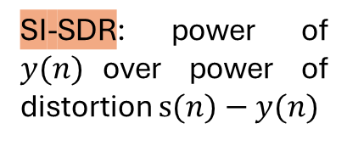
Results: Parameter Tuning (DSS)
13/19
Objective 2
Original + WGN
Original
MSPE: average of the squares of the error between $s\left(n\right)$ and $y(n)$
Denoised
Lower = better
SI-SDR: power of $y(n)$over power of distortion $s(n)−y(n)$
Higher = better
Observations: There is a trade-off between effective removal of noise and attenuation of cardiac sounds
Notes:
Here are the plots of the simulation of the noisy heart sounds in blue, the original clean heart sound in red and the denoised heart sound in yellow. The performance measurement metrics, the MSPE and SI-SDR were used to identify the optimal lambda. The lower the MSPE and the higher the SISDR the better the performance, and the highest performance was measured with lambda = 1. As you can see, small lambda results in a noisy denoised waveform but large lambda results in the attenuation of the S2. Therefore, there is a trade off between effective…

Slide 15
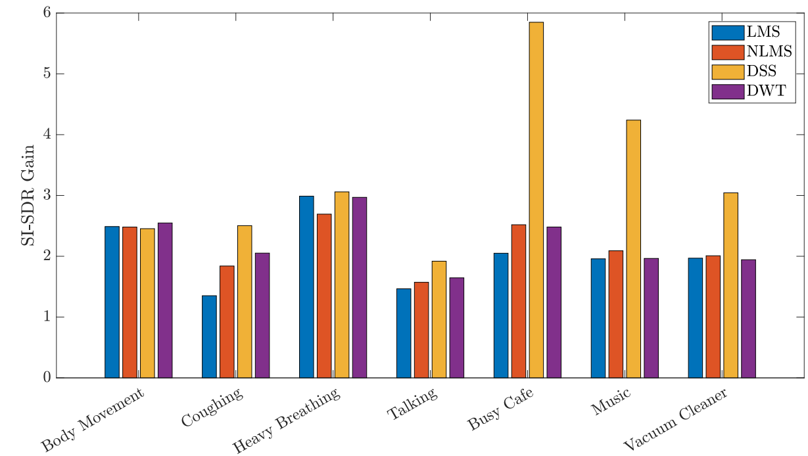
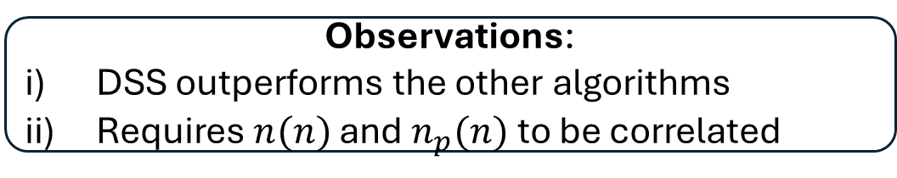
Results: Denoising (post tuning)
14/19
Objective 3
Comparison of denoising algorithms’ average performance after tuning:
Least Mean Square
ANC
Normalised Least Mean Square
Algorithms | Superiority of DSS Over the Algorithm (in %)
LMS | 52.94
NLMS | 43.12
DWT | 40.54
Average | 45.53
n = 5
n = 6
n = 7
n = 7
n = 4
n = 3
n = 3
SI-SDR gain: how much the denoising has improved the SI-SDR
Observations:
DSS outperforms the other algorithms
Requires $n(n)$ and $n_{p}(n)$ to be correlated
Notes:
Heart sounds from a total of 11 participants were acquired in environments contaminated with 7 noise sources. The si-sdr gain, which measures how much the denoising improved the signal quality was used to measure the performance of all algorithms. LMS and NLMS are two implementations of the ANC. On average, DSS outperforms other algorithms as indicated by the green arrows. Specifically, it outperforms on average the other algorithms by 45%. However, as you can see at the red arrow, DSS is outperformed with the body movement noise. This can be explained by some cases where the noise recorded by the primary and reference sensors were not correlated.

Slide 16
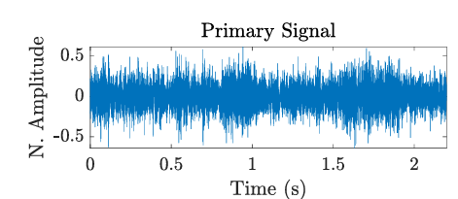
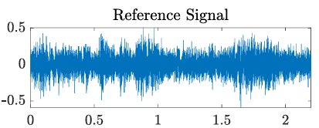

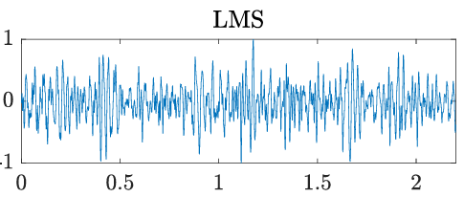
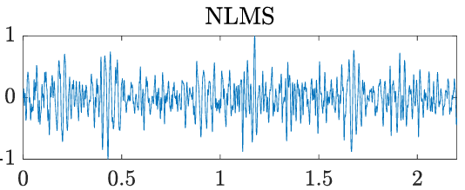
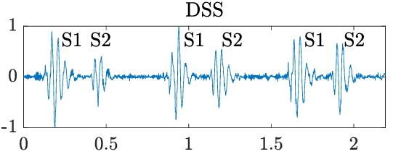
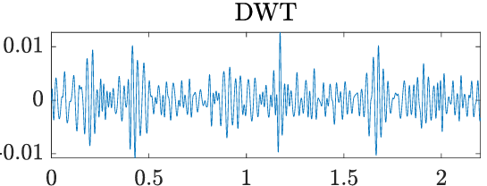
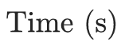
Results: Denoising (post tuning)
15/19
Objective 3
Comparison of waveform of denoised heart sounds:
Observations: Heart sounds denoised with DSS are clearer than others
Notes:
In this example, recordings were achieved in a busy café. It demonstrates how the waveform denoised using DSS is much clearer than others. Despite the heart sounds being not identifiable in the primary signal, s1 and s2 are clearly visible in the DSS waveform.

Slide 17
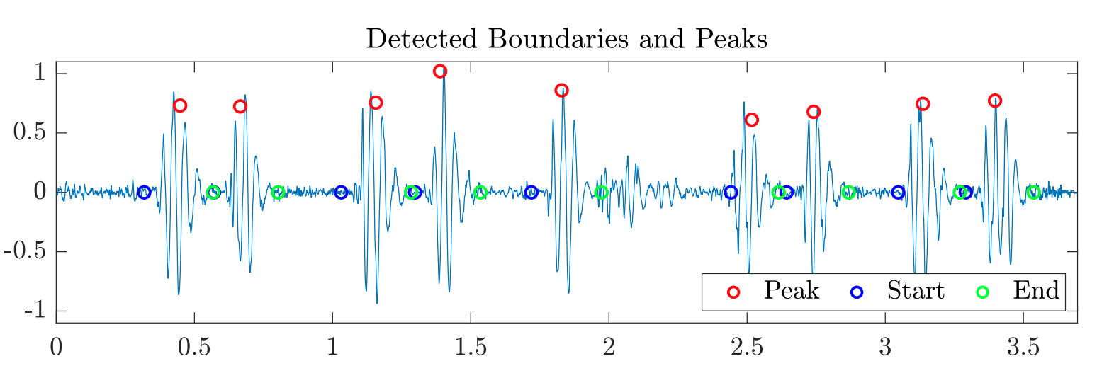

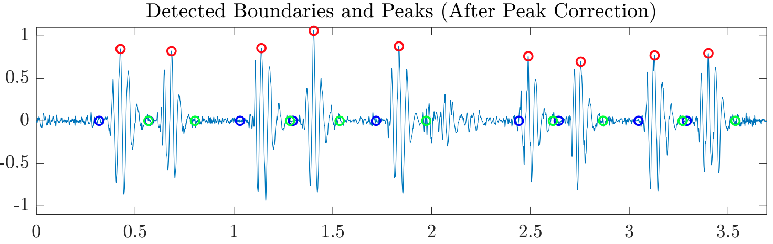
Results: Segmentation
16/19
Objective 4
Peak Correction: to rectify the delay between ground truth peaks and detected peaks
End of FHS
Start of FHS
Observations: Time misalignment is corrected
Notes:
The fhs were correctly identified, as indicated by the red circles, as well as the start and end boundaries indicated by the blue and green circles. However, a slight time misalignment of the fhs was observed, which was rectified after applying peak correction. The circles align with the maxima of the fhs.

Slide 18
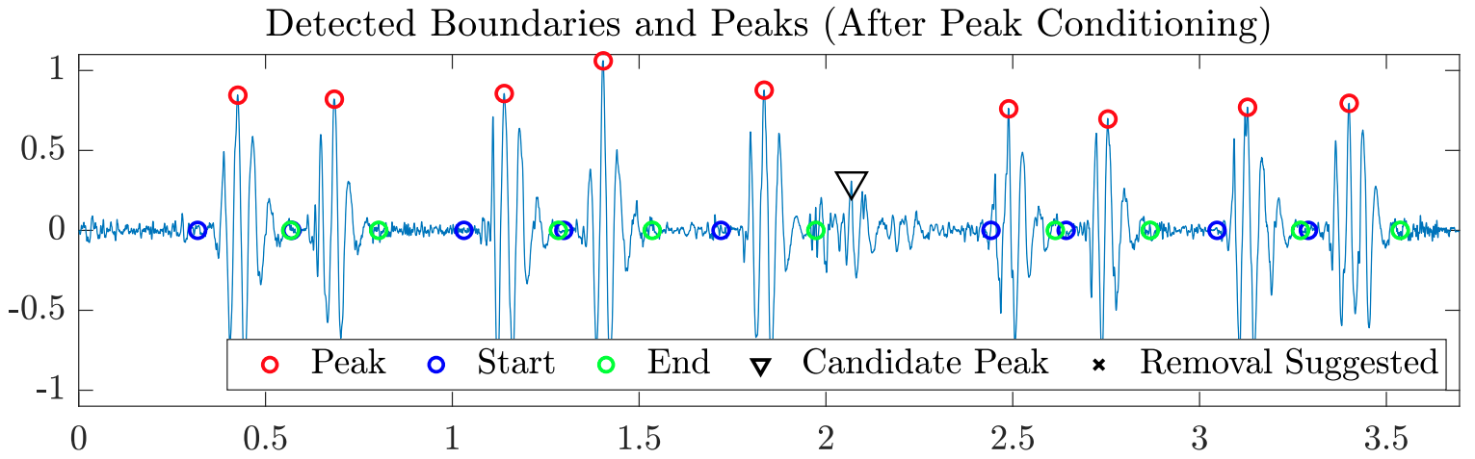
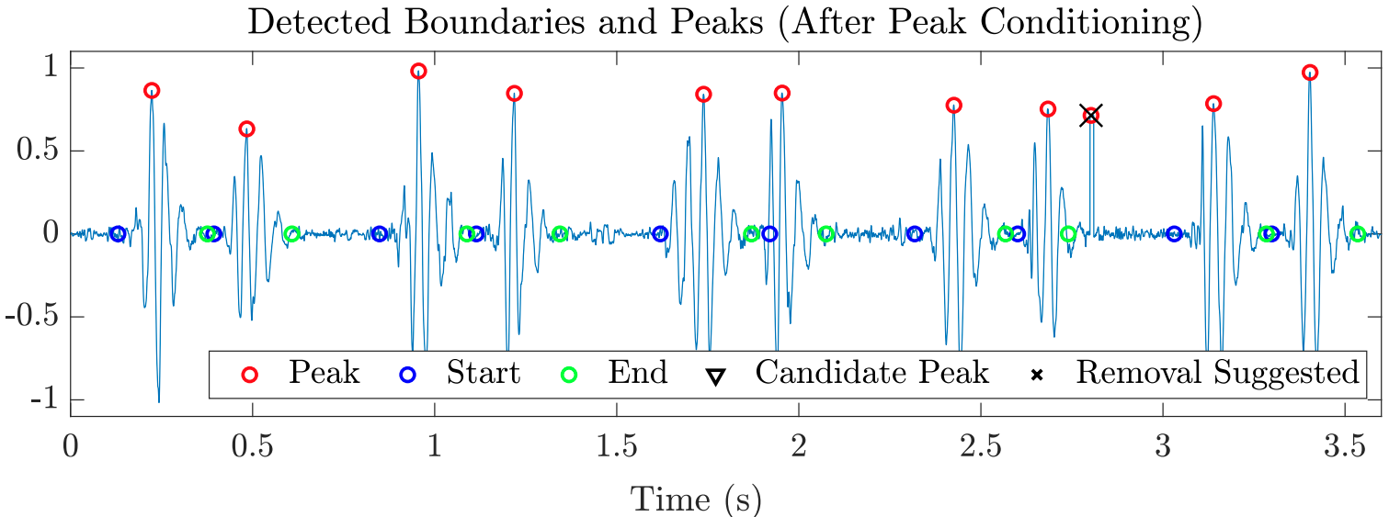
Results: Segmentation
17/19
Objective 4
Peak Conditioning: to identify any missed peaks and remove false peaks
Δ
x
Observations: Candidate peak is identified and extra peak is suggested to be removed
Notes:
Peak conditioning to identify any missed peaks and remove false peaks was then applied during a second pass of the segmentation. A low amplitude s2 which was missed during the first pass is now identified as a candidate peak, while an extra peak due to an artefact is now suggested to be removed.

Slide 19
Results: Segmentation
18/19
Objective 4
Metric (%) | Peaks (pre-conditioning) | Peaks (post-conditioning) | Start | End
Sensitivity | 52.94 | 82.70 | 91.41 | 91.41
Positive Predictivity | 43.12 | 98.15 | 83.49 | 98.81
Accuracy | 77.54 | 82.70 | 90.79 | 90.35
Detection Error Rate | 40.54 | 22.44 | 10.61 | 11.21
Average | 58.27 | 85.28 | 88.77 | 92.34
Higher = better
Lower = better
Observations:
i) In general, start and end boundaries are better identified than the peaks
ii) Peak-conditioning improves the performance
Notes:
Finally, the segmentation performance was measured using these four metrics. In general, the start and end boundaries are better identified that the peaks as indicated by the higher average and peak conditioning improves the performance by 27%.

Slide 20

Conclusion
19/19
Objective 2: Tuning of the Parameters
Attenuation factor $λ$ must be carefully selected to effectively remove noise without
attenuating cardiac sounds.
Especially important with small amplitude heart sounds or murmurs.
Future work: tune with noise other than WGN.
Objective 3: Denoising of Real-world Heart Sounds
Addressed the gap in research of multi-sensor-based denoising algorithms.
DSS successfully outperformed other algorithms by an average of 45.53%.
Future work: use a larger and more varied subject base.
Objective 4: Segmentation of Denoised Heart Sounds
Segmentation algorithm successfully identified the FHS and boundaries.
Peak conditioning improved the performance by 27.01%.
However, performance is below the literature → use hidden Markov model.
Notes:
This is especially important with small amplitude heart sounds or murmurs, which are indicators of cardiac pathologies as heavy attenuation of murmurs might lead to misdiagnosis.
To further refine the selection of λ, we can tune it based on denoising HS contaminated with everyday noise sources instead of solely relying on WGN.
Use alternative such as the HMM which is considered to be a state of the art segmentation algorithm

Slide 21
References
[1] W. H. Organization, “Cardiovascular diseases,” last accessed 19 May 2024. [Online]. Available: https://www.who.int/health-topics/cardiovascular-diseases#tab=tab 1
[2] H. A. Skopicki and G. Gubernikoff, “Physical examination in the cardiac intensive care unit,” Cardiac Intensive Care (Second Edition), pp. 36–50, 2010.
[3] P. Carvalho, P. Gil, J. Henriques, L. Eug´enio, and M. Antunes, “Low complexity algorithm for heart sound segmentation using the variance fractal dimension,” IEEE International Workshop on Intelligent Signal Processing, 2005, pp. 194–199, 2005.
[4] S. Aziz, M. U. Khan, M. Alhaisoni, T. Akram, and M. Altaf, “Phonocardiogram signal processing for automatic diagnosis of congenital heart disorders through fusion of temporal and cepstral features,” Sensors, vol. 13, p. 3790, 2020.
[5] P. Varady, L. Wildt, Z. Benyo, and A. Hein, “An advanced method in fetal phonocardiography,” Computer Methods and Programs in Biomedicine, vol. 71, pp. 283–296, 2003.

Slide 22
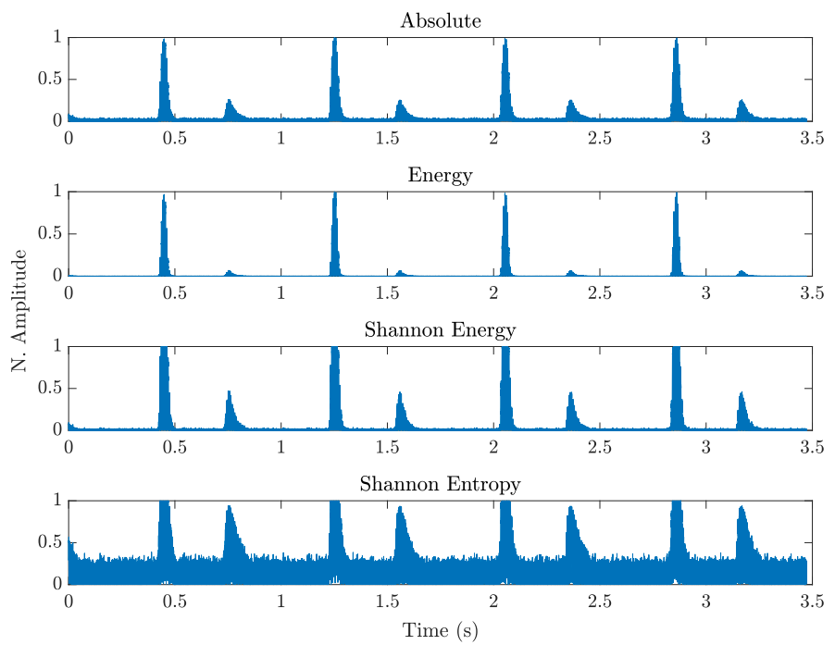
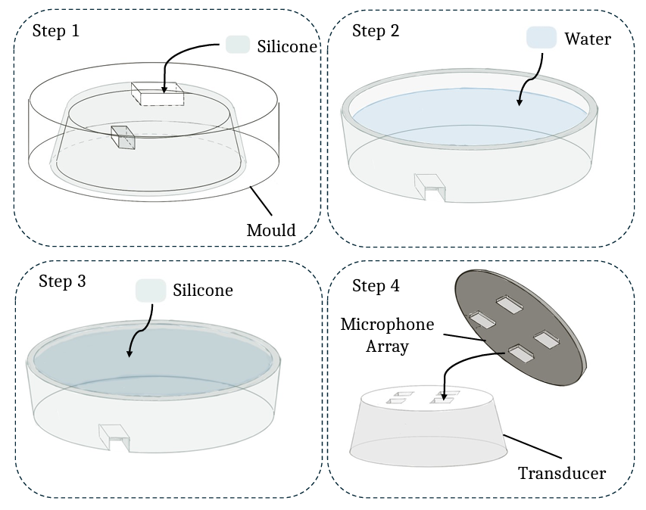
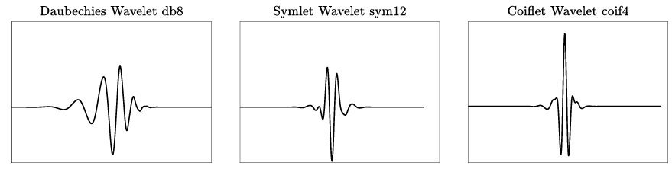
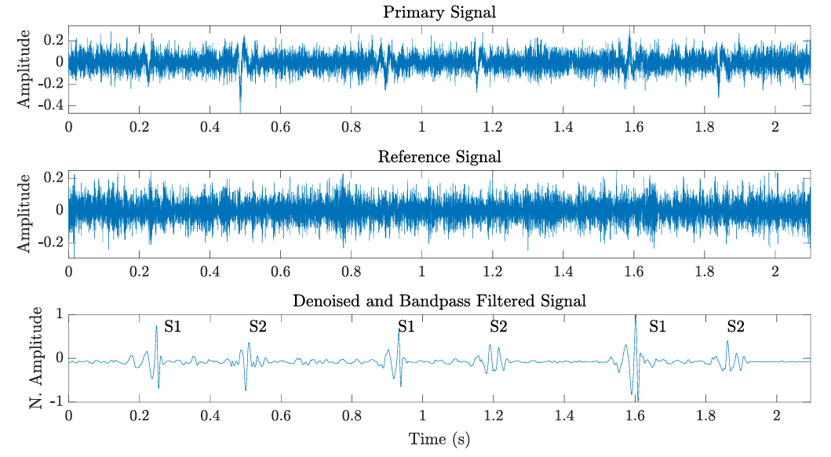
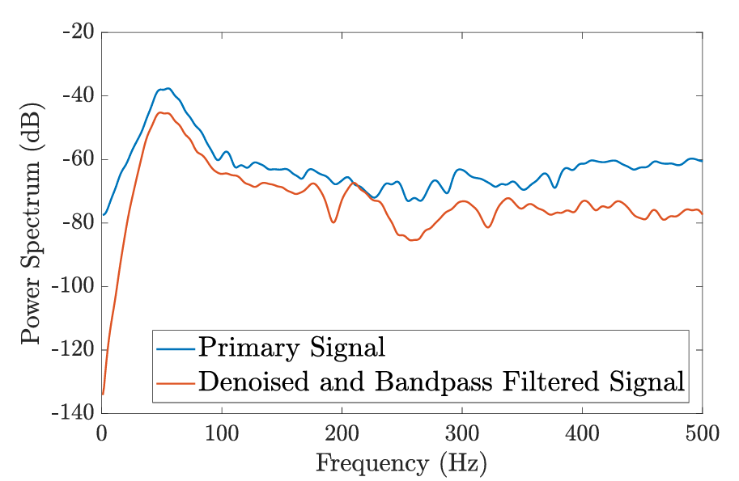





Thank you!

Slide 23

Appendix
Fabrication of the water-silicone acoustic transducer:

Slide 24

Appendix
Discrete Wavelet Transform:

Slide 25








Appendix
Primary signal: $x\left(n\right)=s\left(n\right)+n_{p}\left(n\right)$ Reference signal: $n(n)$
Noise
Noise-contaminated heart sound
Clean heart sound
Correlated to
Adaptive Noise Cancellation (ANC)
Dual Spectral Subtraction (DSS)
$$x(n)$$
$$e(n)$$
$$y(n)$$
$$n_{p}(n)$$
$$n′(n)$$
$$n(n)$$

Slide 26



Appendix
1. Extract the envelope of the denoised heart sound
2. Find the peaks S1 and S2
$$y(n)$$
3. Find the boundaries of the peaks
Start and end points of peaks
Peaks

Slide 27



Appendix
Equations of the performance measurement metrics for denoising:
MSPE

Slide 28

Appendix
Waveform of denoised heart sound with baseline wandering:

Slide 29

Appendix
Summary of tuned parameters:

Slide 30

Appendix
Parameter tuning for DWT:

Slide 31

Appendix
Parameter tuning for ANC:

Slide 32

Appendix
Emphasises the medium-amplitude signal and attenuates the low-amplitude signal.
$$E=−y^{2}\left(n\right)×log⁡(y^{2}\left(n\right))$$

Slide 33

Appendix
Case where a noisy peak located closer to S1 than S2 is identified as an FHS. Ta < Tb < Tc results in the sequence [‘systole’, ‘systole’]

Slide 34

Appendix
Decision rule for identification of missed FHS. Low-amplitude S2 is missed during the first-pass.

Slide 35

Appendix
Decision rule for false peak removal. Noisy peak is identified as a peak in the first-pass.

Slide 36

Appendix
Equations of the performance measurement metrics for segmentation:

Slide 37







Methods: Adaptive Noise Cancellation
Methods
ANC in time domain
Heart sound: $s(n)$
Primary signal: $x(n)$
Error signal: $e(n)$
$$+$$
Primary noise: $n_{p}(n)$
$$+$$
Inputs: $x\left(n\right)=s\left(n\right)+n_{p}\left(n\right)$ and $n\left(n\right)$
Filter estimates $n′\left(n\right)$
Output: $e\left(n\right)=x\left(n\right)−n^{′}\left(n\right)=s\left(n\right)+n_{p}\left(n\right)−n′(n)$
Update the filter to approach $n′\left(n\right)≈n_{p}(n)$
Estimated primary noise: $n′(n)$
Reference signal: $n(n)$
Update

Slide 38


Methods: Adaptive Noise Cancellation
Methods
ANC in time domain
Heart sound: $s(n)$
Primary signal: $x(n)$
Error signal: $e(n)$
$$+$$
Primary noise: $n_{p}(n)$
$$+$$
Inputs: $x\left(n\right)=s\left(n\right)+n_{p}\left(n\right)$ and $n\left(n\right)$
Filter estimates $n′\left(n\right)$
Output: $e\left(n\right)=x\left(n\right)−n^{′}\left(n\right)=s\left(n\right)+n_{p}\left(n\right)−n′(n)$
Update the filter to approach $n′\left(n\right)≈n_{p}(n)$
Estimated primary noise: $n′(n)$
Reference signal: $n(n)$
Update

Slide 39



Methods: Adaptive Noise Cancellation
Methods
ANC in time domain
Heart sound: $s(n)$
Primary signal: $x(n)$
Denoised signal: $y(n)$
$$+$$
Primary noise: $n_{p}(n)$
$$+$$
Estimated primary noise: $n′(n)$
$$n′\left(n\right)≈n_{p}(n)$$
Reference signal: $n(n)$
Update

Slide 40



Results: Denoising (post tuning)
Results
Objective 3
Example of DSS applied on noisy heart sounds:

